Slide 1

Default Risk Analysis
Manasi Mahish

Slide 2
Introduction
Who at risk?
Any financial institution lending money
Home credit (here) which provides loans to people with little to no credit history
Why risk analysis?
to avoid lending money to financially unstable and credit-unworthy borrowers
How risk analysis is done?
Collecting all finance related data of the applicant
Annuity, total credit amount, installment, previous loans, income, age, employment history, demographic information, etc.
Employ appropriate ML algorithm to predict whether an applicant would default or not in case the loan approved
ML algorithm: logistic regression, random forest, LightGBM
Performance metric: ROC AUC score with a target score as 0.79

Slide 3
Data preparation
Assess variable type (i.e., float/integer/categorical), and unique value for integer/categorical
Percent missing data and dealing with them
Assess frequency distribution
Create statistical summary
Find anomalies if any and dealing with them
Transformation of categorical variables
LabelEncoder() for categories w/ unique value <=2
One hot encoding (.get_dummies()) for unique category value >2
Assess correlation with target variable
Merging with train table for features from other than main tables
Saving memory by converting the data type, and clearing memory

Slide 4
Dataset: train/test
Contains information about loan application at Home Credit
Application train: 122 features, 307511 observation
Target feature in train dataset: ‘0’ means loan repaid without difficulty and ‘1’ means difficulty in loan repayment
Among 307511 applicants, 282686 (92%) repaid the loan on time. 24825 (8%) had difficulties in repaying
Among 122 variables in train dataset, 67 variables have missing values, and 41 variables w/ > 50% data missing
The variable types are float (65), integer (41) and categorical (16)
Application test: 121 features, 48744 observations
Primary id: SK_ID_CURR

Slide 5
Data preparation summary: train/test
Variable | Description | Data type | % Missing | Replacement
COMMONAREA_AVG | Normalized information about building where the client lives | float | 69.8723 | 0.00
COMMONAREA_MEDI | Normalized information about building where the client lives | float | 69.8723 | 0.00
COMMONAREA_MODE | Normalized information about building where the client lives | float | 69.8723 | 0.00
NONLIVINGAPARTMENTS_AVG | Normalized information about building where the client lives | float | 69.4330 | 0.00
NONLIVINGAPARTMENTS_MEDI | Normalized information about building where the client lives | float | 69.4330 | 0.00
NONLIVINGAPARTMENTS_MODE | Normalized information about building where the client lives | float | 69.4330 | 0.00
FONDKAPREMONT_MODE | Normalized information about building where the client lives | object | 68.3862 | new category
LIVINGAPARTMENTS_AVG | Normalized information about building where the client lives | float | 68.3550 | 0.00
LIVINGAPARTMENTS_MEDI | Normalized information about building where the client lives | float | 68.3550 | 0.00
LIVINGAPARTMENTS_MODE | Normalized information about building where the client lives | float | 68.3550 | 0.00
FLOORSMIN_AVG | Normalized information about building where the client lives | float | 67.8486 | 0.00
FLOORSMIN_MEDI | Normalized information about building where the client lives | float | 67.8486 | 0.00
FLOORSMIN_MODE | Normalized information about building where the client lives | float | 67.8486 | 0.00
YEARS_BUILD_AVG | Normalized information about building where the client lives | float | 66.4978 | 0.00
YEARS_BUILD_MEDI | Normalized information about building where the client lives | float | 66.4978 | 0.00
YEARS_BUILD_MODE | Normalized information about building where the client lives | float | 66.4978 | 0.00
OWN_CAR_AGE | Age of client's car | float | 65.9908 | 0.00
LANDAREA_AVG | Normalized information about building where the client lives | float | 59.3767 | 0.00
LANDAREA_MEDI | Normalized information about building where the client lives | float | 59.3767 | 0.00
LANDAREA_MODE | Normalized information about building where the client lives | float | 59.3767 | 0.00
BASEMENTAREA_AVG | Normalized information about building where the client lives | float | 58.5160 | 0.00
BASEMENTAREA_MEDI | Normalized information about building where the client lives | float | 58.5160 | 0.00
BASEMENTAREA_MODE | Normalized information about building where the client lives | float | 58.5160 | 0.00
Features with building description has higher % of missing values

Slide 6
Data preparation: train/test
assuming that applicant doesn't own a house
Variable | Variable description | Data type | % missing | Replacement
EXT_SOURCE_1 | Normalized score from external data source | float | 56.3811 | 0.00
NONLIVINGAREA_AVG | Normalized information about building where the client lives | float | 55.1792 | 0.00
NONLIVINGAREA_MEDI | Normalized information about building where the client lives | float | 55.1792 | 0.00
NONLIVINGAREA_MODE | Normalized information about building where the client lives | float | 55.1792 | 0.00
ELEVATORS_AVG | Normalized information about building where the client lives | float | 53.2960 | 0.00
ELEVATORS_MEDI | Normalized information about building where the client lives | float | 53.2960 | 0.00
ELEVATORS_MODE | Normalized information about building where the client lives | float | 53.2960 | 0.00
WALLSMATERIAL_MODE | Normalized information about building where the client lives | object | 50.8408 | new category
APARTMENTS_AVG | Normalized information about building where the client lives | float | 50.7497 | 0.00
APARTMENTS_MEDI | Normalized information about building where the client lives | float | 50.7497 | 0.00
APARTMENTS_MODE | Normalized information about building where the client lives | float | 50.7497 | 0.00
ENTRANCES_AVG | Normalized information about building where the client lives | float | 50.3488 | 0.00
ENTRANCES_MEDI | Normalized information about building where the client lives | float | 50.3488 | 0.00
ENTRANCES_MODE | Normalized information about building where the client lives | float | 50.3488 | 0.00
LIVINGAREA_AVG | Normalized information about building where the client lives | float | 50.1933 | 0.00
LIVINGAREA_MEDI | Normalized information about building where the client lives | float | 50.1933 | 0.00
LIVINGAREA_MODE | Normalized information about building where the client lives | float | 50.1933 | 0.00
HOUSETYPE_MODE | Normalized information about building where the client lives | object | 50.1761 | new category
FLOORSMAX_AVG | Normalized information about building where the client lives | float | 49.7608 | 0.00
FLOORSMAX_MEDI | Normalized information about building where the client lives | float | 49.7608 | 0.00
FLOORSMAX_MODE | Normalized information about building where the client lives | float | 49.7608 | 0.00
YEARS_BEGINEXPLUATATION_AVG | Normalized information about building where the client lives | float | 48.7810 | 0.00
Features with building description has higher % of missing values
‘missing’

Slide 7
Data preparation summary: train/test
Variable | Variable description | Data type | % missing | Replacement
YEARS_BEGINEXPLUATATION_MEDI | Normalized information about building where the client lives | float | 48.7810 | 0.00
YEARS_BEGINEXPLUATATION_MODE | Normalized information about building where the client lives | float | 48.7810 | 0.00
TOTALAREA_MODE | Normalized information about building where the client lives | float | 48.2685 | 0.00
EMERGENCYSTATE_MODE | Normalized information about building where the client lives | object | 47.3983 | new category
OCCUPATION_TYPE | What kind of occupation does the client have | object | 31.3455 | new category
EXT_SOURCE_3 | Normalized score from external data source | float | 19.8253 | 0.00
AMT_REQ_CREDIT_BUREAU_DAY | Number of enquiries to Credit Bureau about the client one day before application | float | 13.5016 | 0.00
AMT_REQ_CREDIT_BUREAU_HOUR | Number of enquiries to Credit Bureau about the client one hour before application | float | 13.5016 | 0.00
AMT_REQ_CREDIT_BUREAU_MON | Number of enquiries to Credit Bureau about the client one month before application | float | 13.5016 | 0.00
AMT_REQ_CREDIT_BUREAU_QRT | Number of enquiries to Credit Bureau about the client 3 month before application | float | 13.5016 | 0.00
AMT_REQ_CREDIT_BUREAU_WEEK | Number of enquiries to Credit Bureau about the client one week before application | float | 13.5016 | 0.00
AMT_REQ_CREDIT_BUREAU_YEAR | Number of enquiries to Credit Bureau about the client one day year | float | 13.5016 | 0.00
NAME_TYPE_SUITE | Who was accompanying client when he was applying for the loan | object | 0.4201 | Unaccompanied
DEF_30_CNT_SOCIAL_CIRCLE | How many observation of client's social surroundings defaulted on 30 DPD (days past due) | float | 0.3320 | 0.00
DEF_60_CNT_SOCIAL_CIRCLE | How many observation of client's social surroundings defaulted on 60 (days past due) DPD | float | 0.3320 | 0.00
OBS_30_CNT_SOCIAL_CIRCLE | How many observation of client's social surroundings with observable 30 DPD (days past due) default | float | 0.3320 | 0.00
OBS_60_CNT_SOCIAL_CIRCLE | How many observation of client's social surroundings with observable 60 DPD (days past due) default | float | 0.3320 | 0.00
EXT_SOURCE_2 | Normalized score from external data source | float | 0.2146 | 0.00
AMT_GOODS_PRICE | For consumer loans it is the price of the goods for which the loan is given | float | 0.0904 | median
AMT_ANNUITY | Loan annuity | float | 0.0039 | median
CNT_FAM_MEMBERS | How many family members does client have | float | 0.0007 | median
DAYS_LAST_PHONE_CHANGE | How many days before application did client change phone | float | 0.0003 | median

Slide 8
Data preparation summary: train/test
Variable | Variable description | Data type | % missing | Replace with
FLAG_CONT_MOBILE | Was mobile phone reachable (1=YES, 0=NO) | integer | 0.0000 | delete col
FLAG_DOCUMENT_10 | Did client provide document 10 | integer | 0.0000 | delete col
FLAG_DOCUMENT_11 | Did client provide document 11 | integer | 0.0000 | delete col
FLAG_DOCUMENT_12 | Did client provide document 12 | integer | 0.0000 | delete col
FLAG_DOCUMENT_13 | Did client provide document 13 | integer | 0.0000 | delete col
FLAG_DOCUMENT_14 | Did client provide document 14 | integer | 0.0000 | delete col
FLAG_DOCUMENT_15 | Did client provide document 15 | integer | 0.0000 | delete col
FLAG_DOCUMENT_16 | Did client provide document 16 | integer | 0.0000 | delete col
FLAG_DOCUMENT_17 | Did client provide document 17 | integer | 0.0000 | delete col
FLAG_DOCUMENT_18 | Did client provide document 18 | integer | 0.0000 | delete col
FLAG_DOCUMENT_19 | Did client provide document 19 | integer | 0.0000 | delete col
FLAG_DOCUMENT_2 | Did client provide document 2 | integer | 0.0000 | delete col
FLAG_DOCUMENT_20 | Did client provide document 20 | integer | 0.0000 | delete col
FLAG_DOCUMENT_21 | Did client provide document 21 | integer | 0.0000 | delete col
FLAG_DOCUMENT_4 | Did client provide document 4 | integer | 0.0000 | delete col
FLAG_DOCUMENT_5 | Did client provide document 5 | integer | 0.0000 | delete col
FLAG_DOCUMENT_7 | Did client provide document 7 | integer | 0.0000 | delete col
FLAG_DOCUMENT_9 | Did client provide document 9 | integer | 0.0000 | delete col
FLAG_EMAIL | Did client provide email (1=YES, 0=NO) | integer | 0.0000 | delete col
FLAG_MOBIL | Did client provide mobile phone (1=YES, 0=NO) | integer | 0.0000 | delete col
LIVE_REGION_NOT_WORK_REGION | Flag if client's contact address does not match work address (1=different, 0=same) | integer | 0.0000 | delete col
REG_REGION_NOT_LIVE_REGION | Flag if client's permanent address does not match contact address (1=different, 0=same) | integer | 0.0000 | delete col
REG_REGION_NOT_WORK_REGION | Flag if client's permanent address does not match work address (1=different, 0=same) | integer | 0.0000 | delete col
WEEKDAY_APPR_PROCESS_START | On which day of the week did the client apply for the loan | object | 0.0000 | delete col
Removing features having no effect on Target variable

Slide 9
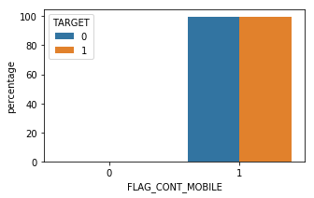
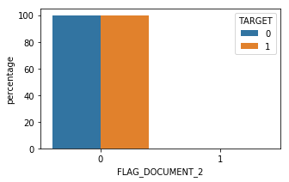
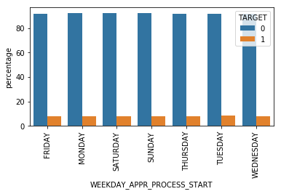
Example distribution of deleted features
FLAG_CONT_MOBILE: Was mobile phone reachable (1=YES, 0=NO)
FLAG_DOCUMENT_2: Did client provide document 2
WEEKDAY_APPR_PROCESS_START: On which day of the week did the client apply for the loan

Slide 10
Correlation with target
Variable | Correlation coefficient
EXT_SOURCE_3 | -0.1789
EXT_SOURCE_2 | -0.1605
EXT_SOURCE_1 | -0.1553
NAME_EDUCATION_TYPE_Higher education | -0.0566
CODE_GENDER_F | -0.0547
DAYS_LAST_PHONE_CHANGE | 0.0552
NAME_INCOME_TYPE_Working | 0.0575
REGION_RATING_CLIENT | 0.0589
REGION_RATING_CLIENT_W_CITY | 0.0609
DAYS_BIRTH | 0.0782

Slide 11
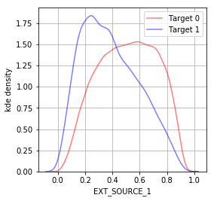
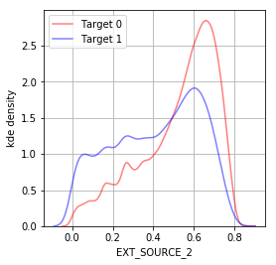
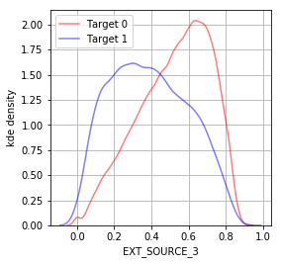
Example density distribution for float: train
EXT_SOURCE_1: for people who repaid loan in time it peaks around 0.6, while for who had difficulties in repaying loan it peaks around 0.2
EXT_SOURCE_2: Similar to EXT_SOURCE_1 but less distinct
EXT_SOURCE_3: Similar to EXT_SOURCE_1

Slide 12
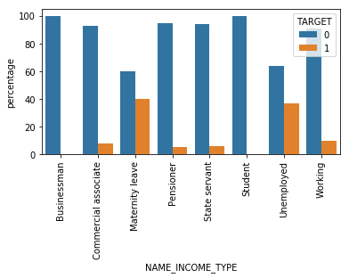
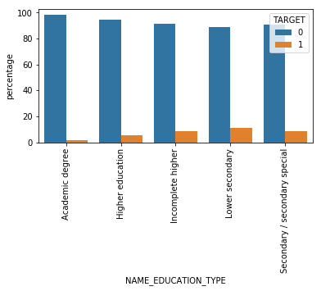
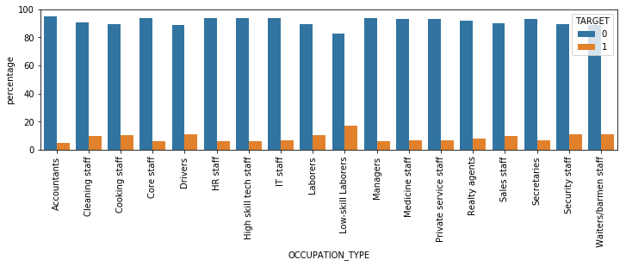
Example barplot for categorical features: train
Income: Unemployed and women on maternity leave have more difficulty in repaying the loan
Education: People with lower secondary education have more difficulty in repaying loan
Occupation type: People with low skilled labor have more difficulty in repaying loan

Slide 13
Dataset: Bureau
Information regarding client’s previous loans that client received from other financial institutions as reported to credit bureau
17 variables: 8 float, 6 integer and 3 categorical variables
7 variables with missing values
Anomaly in DAYS_CREDIT_ENDDATE, clipping the anomalies within 95 percentile as threshold
Label encoding/ one hot coding for categorical variables
Dataset id: aggregation on SK_ID_BUREAU, merged to train/test using SK_ID_CURR
sum and mean for categorical value
count, mean, max, min and sum on numerical values

Slide 14
Data preparation summary: bureau
Variable | Variable description | Data type | % missing | Replacement
AMT_ANNUITY | Annuity of the Credit Bureau credit | float | 71.47 | 0.00
AMT_CREDIT_MAX_OVERDUE | Maximal amount overdue on the Credit Bureau credit so far (at application date of loan in our sample) | float | 65.51 | 0.00
AMT_CREDIT_SUM | Current credit amount for the Credit Bureau credit | float | 0.001 | median
AMT_CREDIT_SUM_DEBT | Current debt on Credit Bureau credit | float | 15.01 | median
AMT_CREDIT_SUM_LIMIT | Current credit limit of credit card reported in Credit Bureau | float | 34.48 | median
DAYS_CREDIT_ENDDATE | Remaining duration of CB credit (in days) at the time of application in Home Credit | float | 6.15/ anomaly | 0.00/ max
DAYS_ENDDATE_FACT | Days since CB credit ended at the time of application in Home Credit (only for closed credit) | float | 36.92 | 0.00
Grouped by SK_ID_CURR using aggregation function
count, mean, max, min and sum on each numeric variables
Sum, mean on each categorical variables
Merged with train/test dataset using SK_ID_CURR variable

Slide 15
Bureau: Correlation with target variable
Original
variable
Unique category value
Aggregation function
Numerical variable | Corrcoef | Categorical variable | Corrcoef
bureau_DAYS_CREDIT_mean | 0.0897 | CREDIT_ACTIVE_Closed_count_norm | -0.0794
bureau_DAYS_CREDIT_min | 0.0752 | CREDIT_ACTIVE_Active_count_norm | 0.0774
bureau_DAYS_CREDIT_UPDATE_mean | 0.0689 | CREDIT_ACTIVE_Active_count | 0.0671
bureau_DAYS_ENDDATE_FACT_min | 0.0559 | CREDIT_TYPE_Microloan_count_norm | 0.0444
bureau_DAYS_CREDIT_ENDDATE_sum | 0.0537 | CREDIT_TYPE_Credit card_count | 0.0348
bureau_DAYS_ENDDATE_FACT_mean | 0.0532 | CREDIT_TYPE_Credit card_count_norm | 0.0347

Slide 16
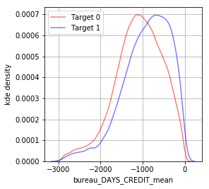
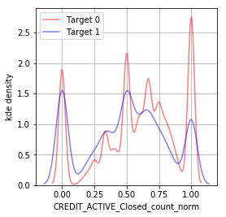
Frequency distribution: bureau
Aggregated numerical variable- bureau_DAYS_CREDIT_mean: Average number of days before current application client applied for Credit Bureau credit
Aggregated categorical variable – CREDIT_ACTIVE_Closed_count_norm: Average ‘closed’ status of the Credit Bureau (CB) reported credits

Slide 17
Dataset: Bureau_balance and correlation
Monthly data about the previous credits in bureau
2 variables: MONTHS_BALANCE (integer), STATUS (categorical)
Bureau_balance variable | Corrcoef
client_bureau_balance_MONTHS_BALANCE_min_mean | 0.0890
client_bureau_balance_MONTHS_BALANCE_count_mean | -0.0802
client_bureau_balance_MONTHS_BALANCE_mean_mean | 0.0764
client_bureau_balance_MONTHS_BALANCE_min_min | 0.0732
client_bureau_balance_MONTHS_BALANCE_sum_mean | 0.0726
client_bureau_balance_MONTHS_BALANCE_count_max | -0.0688
client_bureau_balance_MONTHS_BALANCE_sum_min | 0.0681
client_bureau_balance_STATUS_C_count_mean | -0.0630
client_bureau_balance_STATUS_1_count_norm_mean | 0.0612
client_bureau_balance_STATUS_1_count_norm_max | 0.0611

Slide 18
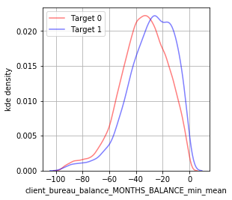
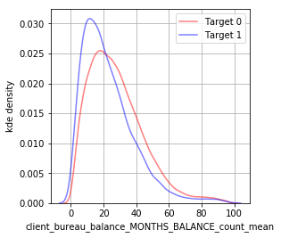
Example frequency distribution: Bureau_balance
Client_bureau_balance_MONTHS_BALANCE_min_mean
Average of lowest values of month of balance relative to application date
Client_bureau_balance_MONTHS_BALANCE_count_mean
Average of number of month of balance relative to application date

Slide 19
Dataset: Previous application
Previous applications for loans at Home Credit of clients who have loans in the application data
37 variables
16 variables with missing values
99% values are missing in RATE_INTEREST_PRIVILEGED and RATE_INTEREST_PRIMARY
5 features have anomalies
clipped with estimated threshold
Categorical value transformed
Categorical and numerical features aggregated and merged to train/test

Slide 20
Data preparation summary: Previous application
Variable | Variable description | Data type | % missing | Replacement
AMT_ANNUITY | Annuity of previous application | float | 22.2867 | 0.00
AMT_CREDIT | Final credit amount on the previous application. This differs from AMT_APPLICATION in a way that the AMT_APPLICATION is the amount for which the client initially applied for, but during our approval process he could have received different amount - AMT_CREDIT | Float | 0.0001 | 0.00
AMT_DOWN_PAYMENT | Down payment on the previous application | Float | 53.6365 | 0.00
AMT_GOODS_PRICE | Goods price of good that client asked for (if applicable) on the previous application | Float | 23.0818 | 0.00
CNT_PAYMENT | Term of previous credit at application of the previous application | integer | 22.2864 | 0.00
DAYS_FIRST_DRAWING | Relative to application date of current application when was the first disbursement of the previous application | Integer | 40.298129/ anomaly | delete
DAYS_FIRST_DUE | Relative to application date of current application when was the first due supposed to be of the previous application | integer | 40.298129/ anomaly | 0 /max
DAYS_LAST_DUE | Relative to application date of current application when was the last due date of the previous application | integer | 40.298129/ anomaly | 0 /max
DAYS_LAST_DUE_1ST_VERSION | Relative to application date of current application when was the first due of the previous application | integer | 40.298129/ anomaly | 0 /max
DAYS_TERMINATION | Relative to application date of current application when was the expected termination of the previous application | integer | 40.298129/ anomaly | 0 /max
NAME_TYPE_SUITE | Who accompanied client when applying for the previous application | object | 49.1198 | Unaccompanied
NFLAG_INSURED_ON_APPROVAL | Did the client requested insurance during the previous application | integer | 40.2981 | new value
PRODUCT_COMBINATION | Detailed product combination of the previous application | object | 0.0207 | new category
RATE_DOWN_PAYMENT | Down payment rate normalized on previous credit | float | 53.6365 | 0.00
RATE_INTEREST_PRIMARY | Interest rate normalized on previous credit | float | 99.6437 | delete
RATE_INTEREST_PRIVILEGED | Interest rate normalized on previous credit | float | 99.6437 | delete
WEEKDAY_APPR_PROCESS_START | On which day of the week did the client apply for previous application | object | 0 | delete

Slide 21
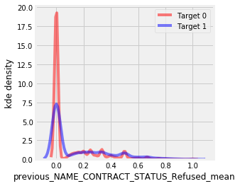
Previous application: correlation with target variable
Previous application table | Corrcoef
previous_NAME_CONTRACT_STATUS_Refused_mean | 0.0777
previous_CODE_REJECT_REASON_XAP_mean | -0.0739
previous_NAME_CONTRACT_STATUS_Refused_sum | 0.0645
previous_NAME_CONTRACT_STATUS_Approved_mean | -0.06
previous_NAME_PRODUCT_TYPE_walk-in_sum | 0.06262
previous_NAME_PRODUCT_TYPE_walk-in_mean | 0.05741
previous_CODE_REJECT_REASON_SCOFR_sum | 0.05628
previous_CODE_REJECT_REASON_SCOFR_mean | 0.05586
previous_CODE_REJECT_REASON_HC_mean | 0.05453
previous_PRODUCT_COMBINATION_Card Street_sum | 0.04795
previous_NAME_CONTRACT_STATUS_Refused_mean:
Mean of contract status as refused

Slide 22
Data summary: POS_CASH balance
Monthly data about previous point of sale or cash loans clients had with Home Credit
Total 8 variables: 2 with missing values
Variable | Variable description | Data type | % missing value | Replace with
MONTHS_BALANCE | Month of balance relative to application date (-1 means the information to the freshest monthly snapshot, 0 means the information at application - often it will be the same as -1 as many banks are not updating the information to Credit Bureau regularly ) | integer | 0 | NA
CNT_INSTALMENT | Term of previous credit (can change over time) | integer | 0.26 | 0
CNT_INSTALMENT_FUTURE | Installments left to pay on the previous credit | integer | 0.26 | 0
NAME_CONTRACT_STATUS | Contract status during the month | object | 0 | NA
SK_DPD | DPD (days past due) during the month of previous credit | integer | 0 | NA
SK_DPD_DEF | DPD during the month with tolerance (debts with low loan amounts are ignored) of the previous credit | integer | 0 | NA

Slide 23
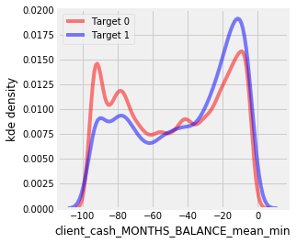
POS_CASH_balance: correlation with target
POS_CASH_balance | corrcoef
client_cash_MONTHS_BALANCE_mean_min | 0.0558
client_cash_MONTHS_BALANCE_max_min | 0.0556
client_cash_MONTHS_BALANCE_min_min | 0.0553
client_cash_MONTHS_BALANCE_max_sum | 0.0427
client_cash_MONTHS_BALANCE_mean_sum | 0.0406
client_cash_CNT_INSTALMENT_FUTURE_max_min | 0.0397
client_cash_CNT_INSTALMENT_FUTURE_mean_min | 0.0393
client_cash_MONTHS_BALANCE_min_sum | 0.0372
client_cash_CNT_INSTALMENT_max_min | 0.0368
client_cash_NAME_CONTRACT_STATUS_Active_mean_sum | -0.0359
client_cash_CNT_INSTALMENT_FUTURE_min_count | -0.0357

Slide 24
Data summary: Credit_card_balance
Monthly data about previous credit cards clients had with Home Credit
Total 23 variables, 9 variables with missing data
Variable | Variable description | Data type | % missing | Replace with
AMT_DRAWINGS_ATM_CURRENT | Amount drawing at ATM during the month of the previous credit | float | 19.5249 | 0.00
AMT_DRAWINGS_OTHER_CURRENT | Amount of other drawings during the month of the previous credit | float | 19.5249 | 0.00
AMT_DRAWINGS_POS_CURRENT | Amount drawing or buying goods during the month of the previous credit | float | 19.5249 | 0.00
AMT_INST_MIN_REGULARITY | Minimal installment for this month of the previous credit | float | 7.9482 | 0.00
AMT_PAYMENT_CURRENT | How much did the client pay during the month on the previous credit | float | 19.9981 | 0.00
CNT_DRAWINGS_ATM_CURRENT | Number of drawings at ATM during this month on the previous credit | integer | 19.5249 | 0.00
CNT_DRAWINGS_OTHER_CURRENT | Number of other drawings during this month on the previous credit | integer | 19.5249 | 0.00
CNT_DRAWINGS_POS_CURRENT | Number of drawings for goods during this month on the previous credit | integer | 19.5249 | 0.00
CNT_INSTALMENT_MATURE_CUM | Number of paid installments on the previous credit | integer | 7.9482 | 0.00

Slide 25
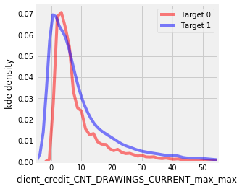
Credit_card_balance : correlation with target
Credit card | corrcoef
client_credit_CNT_DRAWINGS_CURRENT_max_max | 0.1014
client_credit_CNT_DRAWINGS_CURRENT_max_mean | 0.1009
client_credit_CNT_DRAWINGS_CURRENT_max_min | 0.1006
client_credit_CNT_DRAWINGS_CURRENT_mean_max | 0.0826
client_credit_CNT_DRAWINGS_CURRENT_mean_mean | 0.0825
client_credit_CNT_DRAWINGS_CURRENT_mean_min | 0.0823
client_credit_AMT_BALANCE_min_max | 0.0644
client_credit_AMT_RECIVABLE_min_max | 0.0639
client_credit_AMT_TOTAL_RECEIVABLE_min_max | 0.0639
client_credit_AMT_RECIVABLE_min_mean | 0.0638

Slide 26
Data summary: Installments_payments
Payment history for previous loans at Home Credit
Total 8 variables, variables with missing variables are 2
Variable | Variable description | Data type | % missing value | Replace with
NUM_INSTALMENT_VERSION | Version of installment calendar (0 is for credit card) of previous credit. Change of installment version from month to month signifies that some parameter of payment calendar has changed | integer | 0.00 | NA
NUM_INSTALMENT_NUMBER | On which installment we observe payment | integer | 0.00 | NA
DAYS_INSTALMENT | When the installment of previous credit was supposed to be paid (relative to application date of current loan) | integer | 0.00 | NA
DAYS_ENTRY_PAYMENT | When was the installments of previous credit paid actually (relative to application date of current loan) | integer | 0.2135 | 0.00
AMT_INSTALMENT | What was the prescribed installment amount of previous credit on this installment | float | 0.00 | NA
AMT_PAYMENT | What the client actually paid on previous credit on this installment | float | 0.2135 | 0.00

Slide 27
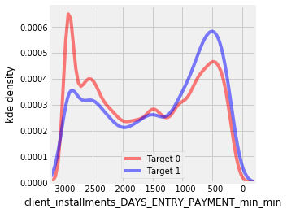
Installment_payments: correlation with Target
Installment_payments | Corrcoef
client_installments_DAYS_ENTRY_PAYMENT_min_min | 0.0588
client_installments_DAYS_INSTALMENT_min_min | 0.0586
client_installments_AMT_PAYMENT_min_sum | -0.0584
client_installments_DAYS_ENTRY_PAYMENT_mean_min | 0.0580
client_installments_DAYS_INSTALMENT_mean_min | 0.0577
client_installments_DAYS_ENTRY_PAYMENT_max_min | 0.0555
client_installments_DAYS_INSTALMENT_max_min | 0.0553
client_installments_DAYS_ENTRY_PAYMENT_min_mean | 0.0454
client_installments_DAYS_INSTALMENT_min_mean | 0.0451
client_installments_DAYS_ENTRY_PAYMENT_mean_mean | 0.0440

Slide 28
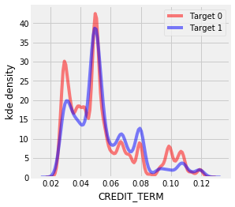
Feature Engineering: domain knowledge
CREDIT_INCOME_PERCENT = AMT_CREDIT / AMT_INCOME_TOTAL
ANNUITY_INCOME_PERCENT = AMT_ANNUITY / AMT_INCOME_TOTAL
CREDIT_TERM = AMT_ANNUITY / AMT_CREDIT
DAYS_EMPLOYED_PERCENT = DAYS_EMPLOYED / DAYS_BIRTH
Domain features | Corrcoef
CREDIT_INCOME_PERCENT | -0.0077
CREDIT_TERM | 0.0127
ANNUITY_INCOME_PERCENT | 0.0143
DAYS_EMPLOYED_PERCENT | 0.0422

Slide 29
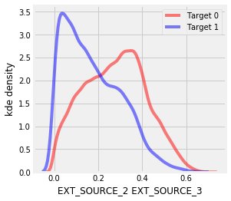
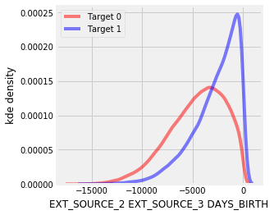
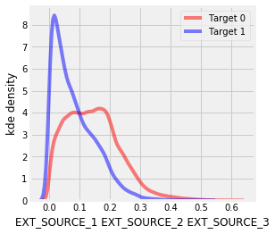
Feature Engineering: Polynomial features
Polynomial features | Corrcoef
EXT_SOURCE_2 EXT_SOURCE_3 | -0.1939
EXT_SOURCE_1 EXT_SOURCE_2 EXT_SOURCE_3 | -0.1896
EXT_SOURCE_2^2 EXT_SOURCE_3 | -0.1764
EXT_SOURCE_2 EXT_SOURCE_3^2 | -0.1723
EXT_SOURCE_1 EXT_SOURCE_2 | -0.1666
EXT_SOURCE_1 EXT_SOURCE_3 | -0.1641
EXT_SOURCE_2 | -0.1603
EXT_SOURCE_1 EXT_SOURCE_2^2 | -0.1569
EXT_SOURCE_3 | -0.1559
EXT_SOURCE_1 EXT_SOURCE_3^2 | -0.1508

Slide 30
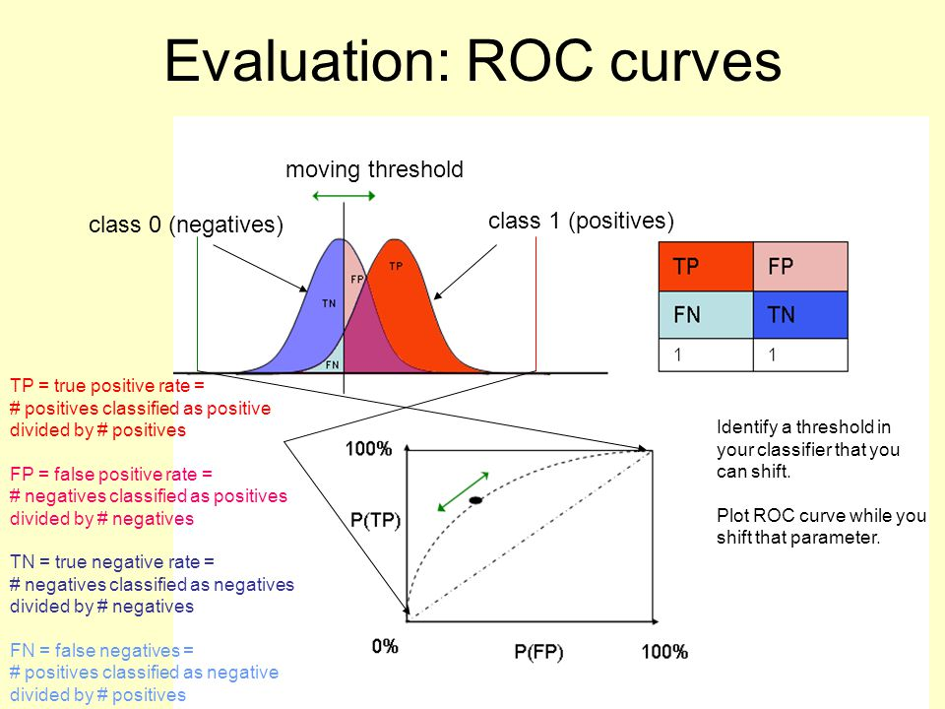
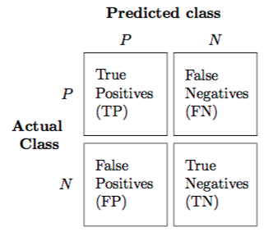
Performance metrics: AUC ROC score
Confusion matrix

Slide 31
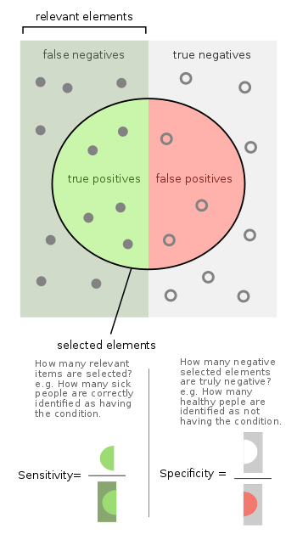
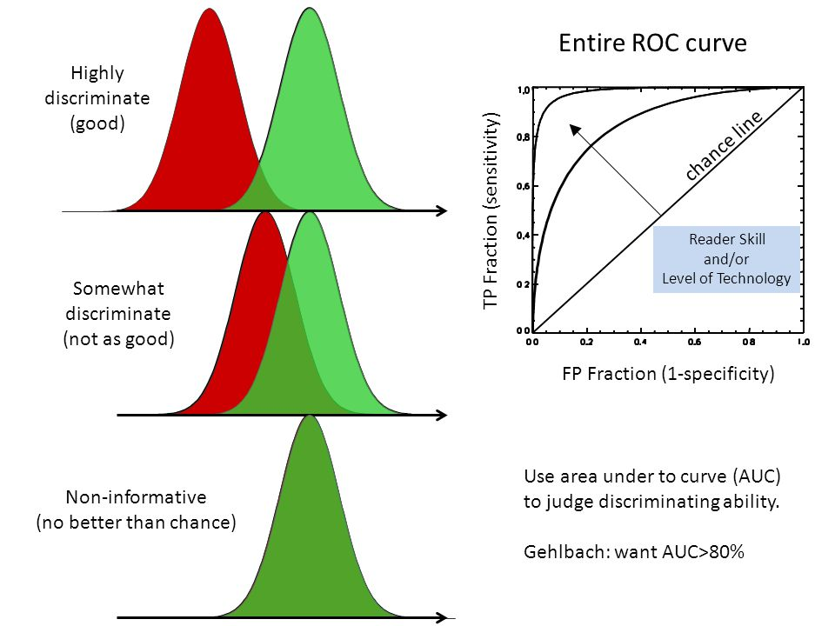
ROC CURVE
Sensitivity /true positive rate, TPR = TP/(TP + FN)
Specificity / true negative rate, TNR = TN/(TN + FP)

Slide 32
Model prediction on classification
ML model | Dataset used | # features | Parameters | ROC AUC score | Significant features
Logistic regression | application_train/test w/ 30% validation | 240 | c = 0.0001 | 0.501
Random forest | application_train/test w/ 30% validation | 240 | n_estimator = 100 | 0.706 | EXT_SOURCE_2, EXT_SOURCE_3, DAYS_BIRTH
LightGBM | application_train/test w/ 5-fold CV | 240 | n_estimator = 10000 | 0.758 | EXT_SOURCE_1, EXT_SOURCE_3, EXT_SOURCE_2
 | application_train/test w/ 5-fold CV | 240+39 engineered features | n_estimator = 10000 | 0.766 | CREDIT_TERM (engineered feature), DAYS_ID_PUBLISH, AMT_ANNUITY
 | all 8 dataset w/ 5-fold CV | 1422 | n_estimator = 10000 | 0.788 | CREDIT_TERM, AMT_ANNUITY, client_installments_AMT_PAYMENT_min_sum

Slide 33



